Slide 1


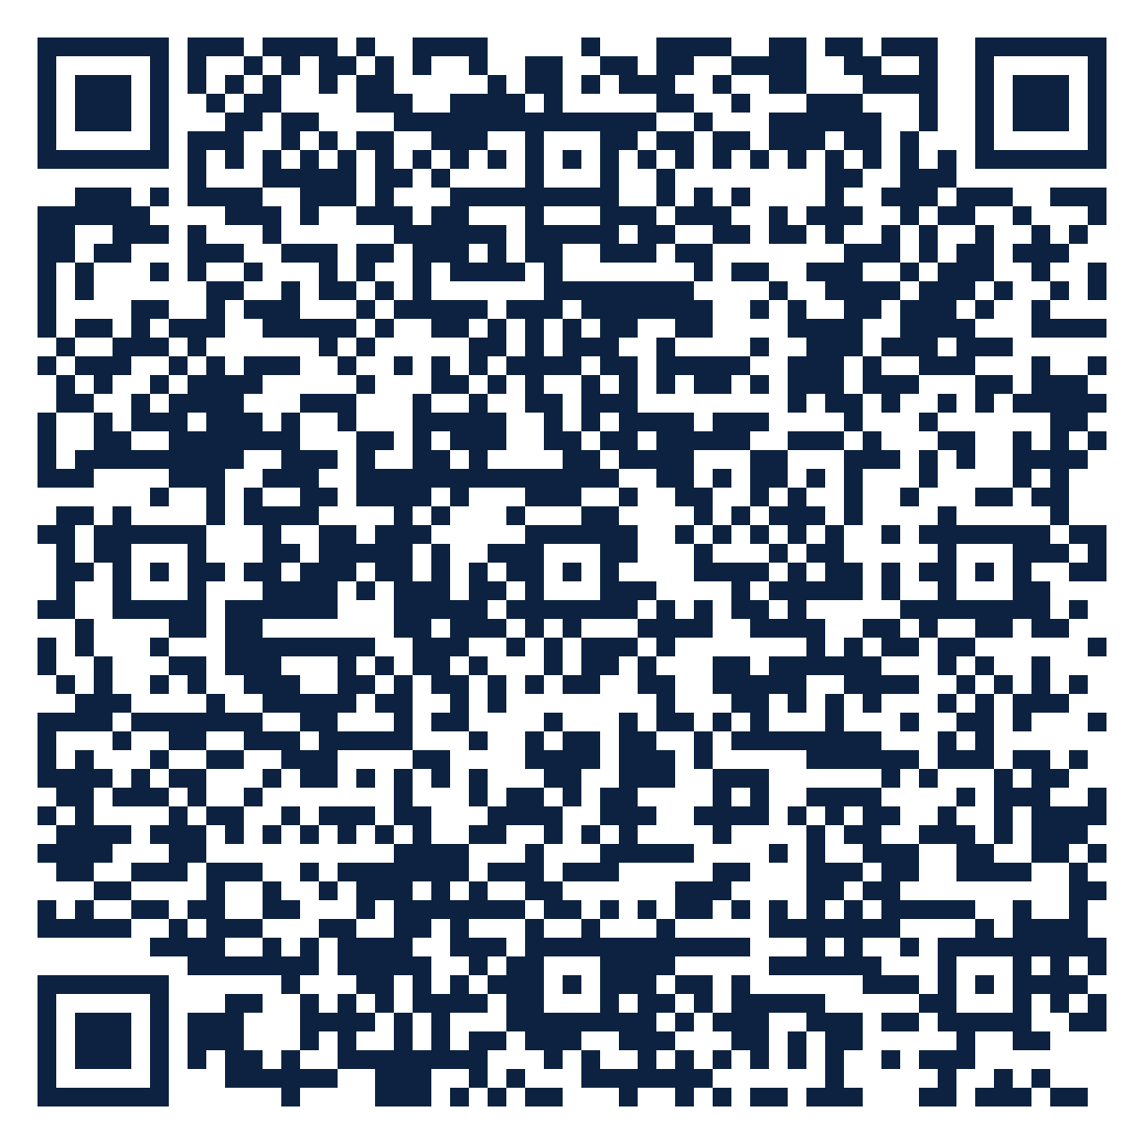
THE SEAT SERIES · FREE ATTENDANCE SCIENCE™ RESOURCE
SEAT
01
Teachers · All grades
Classify Before You Consequence
What should I do in the first ten minutes after a student starts missing school?
10 slides · 2 handouts · evidence from Schools Spared, Children Punished and the Attendance Science™ research base
attendanceusa.org | Questions: info@attendanceusa.org | Free to use and share with attribution
Take a seat
Notes:
Seat 01: Classify Before You Consequence. For classroom teachers, K-12. Open with the question on the slide and invite one minute of discussion. Free resource from Attendance USA; questions to info@attendanceusa.org.

Slide 2
SEAT 01 · 02 THE MOMENT
TEACHERS · ALL GRADES
Maria and the second letter
“
Maria was fourteen when the first truancy letter arrived. She was home two days a week watching her siblings so her mother could cover a shift. Nobody asked why. A second letter followed, then a referral. By the time anyone asked, she had missed six weeks of ninth-grade math.
Source: Schools Spared, Children Punished, Ch. 1 (Maria, composite case)
Every story in this series is a composite or a published case. Names are invented.
attendanceusa.org | Questions: info@attendanceusa.org | Free to use and share with attribution
Take a seat
Notes:
Tell the story in your own words. Source: Schools Spared, Children Punished, Ch. 1 (Maria, composite case). Ask: where have you seen this pattern?

Slide 3
SEAT 01 · 03 THE QUESTION WE HEAR
TEACHERS · ALL GRADES
What teachers are asking
What should I do in the first ten minutes after a student starts missing school?
1
2
3
The letter goes out before anyone asks why.
One absence code is asked to hold four very different stories.
Teachers see the pattern first, yet rarely own the next step.
attendanceusa.org | Questions: info@attendanceusa.org | Free to use and share with attribution
Take a seat
Notes:
These concerns come from the field: Attendance USA briefs, IATDP 2026 sessions, training cohorts and the book's practitioner stories. Ask which one is loudest in your building.

Slide 4
SEAT 01 · 04 NAME IT
TEACHERS · ALL GRADES
Shared words before shared work
A
A
C
Attendance
Absenteeism
Chronic absence
The tally: every presence and every absence.
The reasons: everything around the why of an absence.
Missing 10% or more of the school year, about 18 days, for any reason.
attendanceusa.org | Questions: info@attendanceusa.org | Free to use and share with attribution
Take a seat
Notes:
Definitions follow Schools Spared, Children Punished (glossary), the Attendance Kit, and the instruments' published materials.

Slide 5
SEAT 01 · 05 WHAT THE EVIDENCE SAYS
The numbers behind the moment
~22%
0.64 SD
~40%
of U.S. K-12 students chronically absent in 2024-25, about 10.8 million
lower test scores for students missing 10+ days than for peers
of one district's 'truancy' codes re-coded as withdrawal or avoidance by its registrar
RAND ASDP (2025); AEI Return to Learn Tracker (Malkus, 2026); FutureEd (2026)
Economic Policy Institute (2018), Student Absenteeism: Who Misses School
Schools Spared, Ch. 1, Another Voice from the Field
attendanceusa.org | Questions: info@attendanceusa.org | Free to use and share with attribution
Take a seat
Notes:
Sources: ~22% of U.S. K-12 students chronically absent in 2024-25, about 10.8 million (RAND ASDP (2025); AEI Return to Learn Tracker (Malkus, 2026); FutureEd (2026)); 0.64 SD lower test scores for students missing 10+ days than for peers (Economic Policy Institute (2018), Student Absenteeism: Who Misses School); ~40% of one district's 'truancy' codes re-coded as withdrawal or avoidance by its registrar (Schools Spared, Ch. 1, Another Voice from the Field). Figures labeled illustrative are teaching examples, not data. Check state and local figures against primary sources before presenting.

Slide 6
SEAT 01 · 06 CLASSIFY
TEACHERS · ALL GRADES
Classify before you consequence
Truancy
Withdrawal
Choice-driven, unauthorized absence. The last-resort category, confirmed only after a real conversation.
Family-centered: caregiving, shifts, housing, a ride that never came, economic survival.
Avoidance
Refusal
Climate-driven: a building, class, peer or time of day the student experiences as unsafe.
Anxiety-driven, often with clinical features. Needs health and counseling partners.
attendanceusa.org | Questions: info@attendanceusa.org | Free to use and share with attribution
Take a seat
Notes:
Four-part classification (truancy, withdrawal, avoidance, refusal) from Schools Spared, Children Punished, Ch. 1, and the Attendance Kit Type Cards. Commitment One of No Empty Seats: no formal consequence before a conversation decides the category.

Slide 7
SEAT 01 · 07 MONDAY MOVES
TEACHERS · ALL GRADES
Three moves you can make this week
01
02
03
Cost: $0
Cost: $0
Cost: $0
Ask why first
Write their words
Hand off with a name
One conversation with the student or family before any referral: what happened on the days you missed?
Record the family's own explanation so the team can classify accurately.
Tell your attendance lead which of the four reasons you heard and who follows up by when.
attendanceusa.org | Questions: info@attendanceusa.org | Free to use and share with attribution
Take a seat
Notes:
Monday Morning takeaways follow the book's chapter structure and the IATDP 2026 blueprint: start with what costs nothing. Handout A turns these into a checklist.

Slide 8
SEAT 01 · 08 FIND YOUR DATA
TEACHERS · ALL GRADES
A PRESENCE™ prompt for your building
P
R
E
S
E
N
C
E
Problem definition
Research evidence
Environmental context
Statistical analysis
Equity assessment
Network and partnership
Compliance and legal
Evidence-based recommendations
YOUR PROMPT
Pull last semester's codes for your class. How many 'unexcused' days would turn out to be withdrawal or avoidance after one family call?
attendanceusa.org | Questions: info@attendanceusa.org | Free to use and share with attribution
Take a seat
Notes:
PRESENCE: Problem definition, Research evidence, Environmental context, Statistical analysis, Equity assessment, Network and partnership, Compliance and legal, Evidence-based recommendations. Highlighted letters show the steps this prompt exercises. Handout B is the worksheet.

Slide 9
SEAT 01 · 09 AVOID AND MEASURE
TEACHERS · ALL GRADES
Common missteps, and how you will know it works
Inferring the category from the code alone
LEADING INDICATOR · Moves first
✕
Share of cases classified before any letter
Skipping the conversation because a pattern looks familiar
✕
LAGGING INDICATOR · Confirms it worked
Chronic absence rate for your focus students
Treating classification as one-time; a category can shift during the year
✕
attendanceusa.org | Questions: info@attendanceusa.org | Free to use and share with attribution
Take a seat
Notes:
Missteps adapted from each chapter's Common Missteps section and the Kit tip sheets. Leading indicators move first; lagging indicators confirm.

Slide 10
SEAT 01 · 10 TAKE YOUR SEAT
Join 1,000 Seats at the national table
Scan to take your seat: free membership in Attendance USA and the weekly Attendance Intelligence Brief, with new research, policy across the states, and tools from the field of Attendance Science™.
QUESTIONS
info@attendanceusa.org
LEARN MORE
attendanceusa.org
Take Your Seat
HANDOUTS
Seat Card (A) and Find Your Data worksheet (B)
1,000 Seats campaign
KEEP GOING IN THIS SERIES
Seat 02: Early Absence Is a Logistics Signal
Seat 03: Building the Habit of Showing Up
Seat 04: The Hallway Test
Every seat filled is one more person working to make showing up possible.
attendanceusa.org | Questions: info@attendanceusa.org | Free to use and share with attribution
Take a seat
Notes:
Close with the question: have we created a place worth showing up for? Point to the QR code (1,000 Seats subscribe form). Questions: info@attendanceusa.org. Website: attendanceusa.org.

