Slide 1


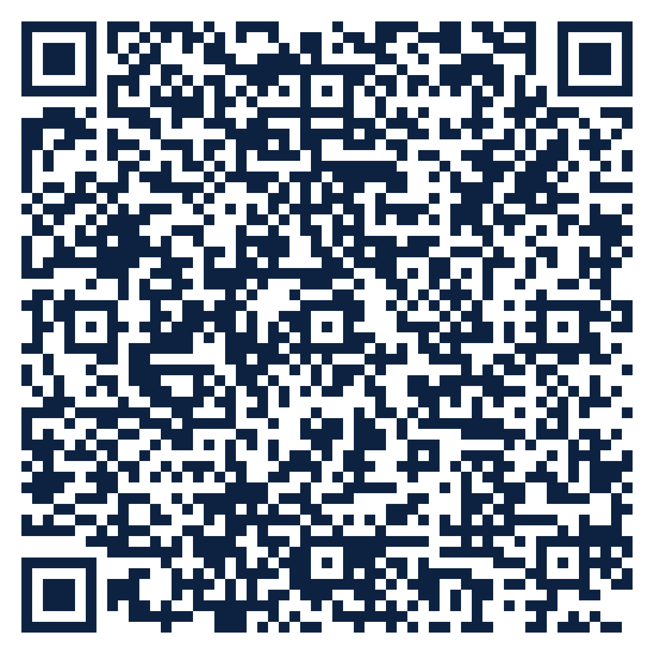
THE SEAT SERIES · FREE ATTENDANCE SCIENCE™ RESOURCE
SEAT
09
Practitioners · K-12
The Four Reasons
How do I classify an absence accurately enough to choose the right response?
10 slides · 2 handouts · evidence from Schools Spared, Children Punished and the Attendance Science™ research base
attendanceusa.org | Questions: info@attendanceusa.org | Free to use and share with attribution
Take a seat
Notes:
Seat 09: The Four Reasons. For social workers, counselors, attendance officers and community practitioners. Open with the question on the slide and invite one minute of discussion. Free resource from Attendance USA; questions to info@attendanceusa.org.

Slide 2
SEAT 09 · 02 THE MOMENT
PRACTITIONERS · K-12
Four children, the same twenty days
“
Four students can miss the same twenty days for four different reasons: a caregiving shift, a hostile hallway, clinical anxiety, a choice made with friends. Under most district policy today, all four receive the same truancy letter. Classification changes the intervention, not just the vocabulary.
Source: Gentle-Genitty, Schools Spared, Children Punished (Attendance USA, 2026)
Every story in this series is a composite or a published case. Names are invented.
attendanceusa.org | Questions: info@attendanceusa.org | Free to use and share with attribution
Take a seat
Notes:
Tell the story in your own words. Source: Gentle-Genitty, Schools Spared, Children Punished (Attendance USA, 2026). Ask: where have you seen this pattern?

Slide 3
SEAT 09 · 03 THE QUESTION WE HEAR
PRACTITIONERS · K-12
What practitioners are asking
How do I classify an absence accurately enough to choose the right response?
1
2
3
Policies built around one word and one lever: truancy and enforcement.
Codes like 'unexcused' record paperwork, not cause.
Practitioners are asked to fix what was misclassified upstream.
attendanceusa.org | Questions: info@attendanceusa.org | Free to use and share with attribution
Take a seat
Notes:
These concerns come from the field: Attendance USA briefs, IATDP 2026 sessions, training cohorts and the book's practitioner stories. Ask which one is loudest in your building.

Slide 4
SEAT 09 · 04 NAME IT
PRACTITIONERS · K-12
Shared words before shared work
C
F
S
Classification
Falsifiable
School-level metric
The first and most consequential decision a school makes about a struggling student.
A category a specific case can prove wrong, which makes it science.
Chronic absence counts all absences; classification turns the count into a cause.
attendanceusa.org | Questions: info@attendanceusa.org | Free to use and share with attribution
Take a seat
Notes:
Definitions follow Schools Spared, Children Punished (glossary), the Attendance Kit, and the instruments' published materials.

Slide 5
SEAT 09 · 05 WHAT THE EVIDENCE SAYS
The numbers behind the moment
4
6
~40%
categories: truancy, withdrawal, avoidance, refusal
Kit absence patterns that map onto the four reasons
of one district's 'truancy' was withdrawal or avoidance once re-coded
Schools Spared, Children Punished, Ch. 1 (Maria, composite case)
Attendance USA Attendance Kit, Items 9 and 10 (Absenteeism Type Cards, Intervention Tip Sheets)
Schools Spared, Ch. 1, Another Voice from the Field
attendanceusa.org | Questions: info@attendanceusa.org | Free to use and share with attribution
Take a seat
Notes:
Sources: 4 categories: truancy, withdrawal, avoidance, refusal (Schools Spared, Children Punished, Ch. 1 (Maria, composite case)); 6 Kit absence patterns that map onto the four reasons (Attendance USA Attendance Kit, Items 9 and 10 (Absenteeism Type Cards, Intervention Tip Sheets)); ~40% of one district's 'truancy' was withdrawal or avoidance once re-coded (Schools Spared, Ch. 1, Another Voice from the Field). Figures labeled illustrative are teaching examples, not data. Check state and local figures against primary sources before presenting.

Slide 6
SEAT 09 · 06 CLASSIFY
PRACTITIONERS · K-12
Classify before you consequence
Truancy
Withdrawal
Choice-driven, unauthorized absence. The last-resort category, confirmed only after a real conversation.
Family-centered: caregiving, shifts, housing, a ride that never came, economic survival.
Avoidance
Refusal
Climate-driven: a building, class, peer or time of day the student experiences as unsafe.
Anxiety-driven, often with clinical features. Needs health and counseling partners.
attendanceusa.org | Questions: info@attendanceusa.org | Free to use and share with attribution
Take a seat
Notes:
Four-part classification (truancy, withdrawal, avoidance, refusal) from Schools Spared, Children Punished, Ch. 1, and the Attendance Kit Type Cards. Commitment One of No Empty Seats: no formal consequence before a conversation decides the category.

Slide 7
SEAT 09 · 07 MONDAY MOVES
PRACTITIONERS · K-12
Three moves you can make this week
01
02
03
Cost: $0
Low cost
Cost: $0
Interview before you code
Use the Type Cards
Re-classify on schedule
A direct conversation with student and family decides the category.
Match markers to the Kit's six patterns and their first moves.
Review each case at 30 days; categories can shift.
attendanceusa.org | Questions: info@attendanceusa.org | Free to use and share with attribution
Take a seat
Notes:
Monday Morning takeaways follow the book's chapter structure and the IATDP 2026 blueprint: start with what costs nothing. Handout A turns these into a checklist.

Slide 8
SEAT 09 · 08 FIND YOUR DATA
PRACTITIONERS · K-12
A PRESENCE™ prompt for your building
P
R
E
S
E
N
C
E
Problem definition
Research evidence
Environmental context
Statistical analysis
Equity assessment
Network and partnership
Compliance and legal
Evidence-based recommendations
YOUR PROMPT
Re-code a sample of last semester's unexcused absences using case notes. What share is truancy once the reasons are known?
attendanceusa.org | Questions: info@attendanceusa.org | Free to use and share with attribution
Take a seat
Notes:
PRESENCE: Problem definition, Research evidence, Environmental context, Statistical analysis, Equity assessment, Network and partnership, Compliance and legal, Evidence-based recommendations. Highlighted letters show the steps this prompt exercises. Handout B is the worksheet.

Slide 9
SEAT 09 · 09 AVOID AND MEASURE
PRACTITIONERS · K-12
Common missteps, and how you will know it works
Assuming the category is self-evident from attendance codes
LEADING INDICATOR · Moves first
✕
Cases with a documented classification
Inferring cause from pattern alone
✕
LAGGING INDICATOR · Confirms it worked
Truancy referrals avoided after classification
Treating classification as a one-time event
✕
attendanceusa.org | Questions: info@attendanceusa.org | Free to use and share with attribution
Take a seat
Notes:
Missteps adapted from each chapter's Common Missteps section and the Kit tip sheets. Leading indicators move first; lagging indicators confirm.

Slide 10
SEAT 09 · 10 TAKE YOUR SEAT
Join 1,000 Seats at the national table
Scan to take your seat: free membership in Attendance USA and the weekly Attendance Intelligence Brief, with new research, policy across the states, and tools from the field of Attendance Science™.
QUESTIONS
info@attendanceusa.org
LEARN MORE
attendanceusa.org
Take Your Seat
HANDOUTS
Seat Card (A) and Find Your Data worksheet (B)
1,000 Seats campaign
KEEP GOING IN THIS SERIES
Seat 10: SALT: A Strengths-First Response
Seat 11: The Family Stability Conversation
Seat 12: Refusal and Avoidance: Matching Care to Cause
Every seat filled is one more person working to make showing up possible.
attendanceusa.org | Questions: info@attendanceusa.org | Free to use and share with attribution
Take a seat
Notes:
Close with the question: have we created a place worth showing up for? Point to the QR code (1,000 Seats subscribe form). Questions: info@attendanceusa.org. Website: attendanceusa.org.

