Slide 1


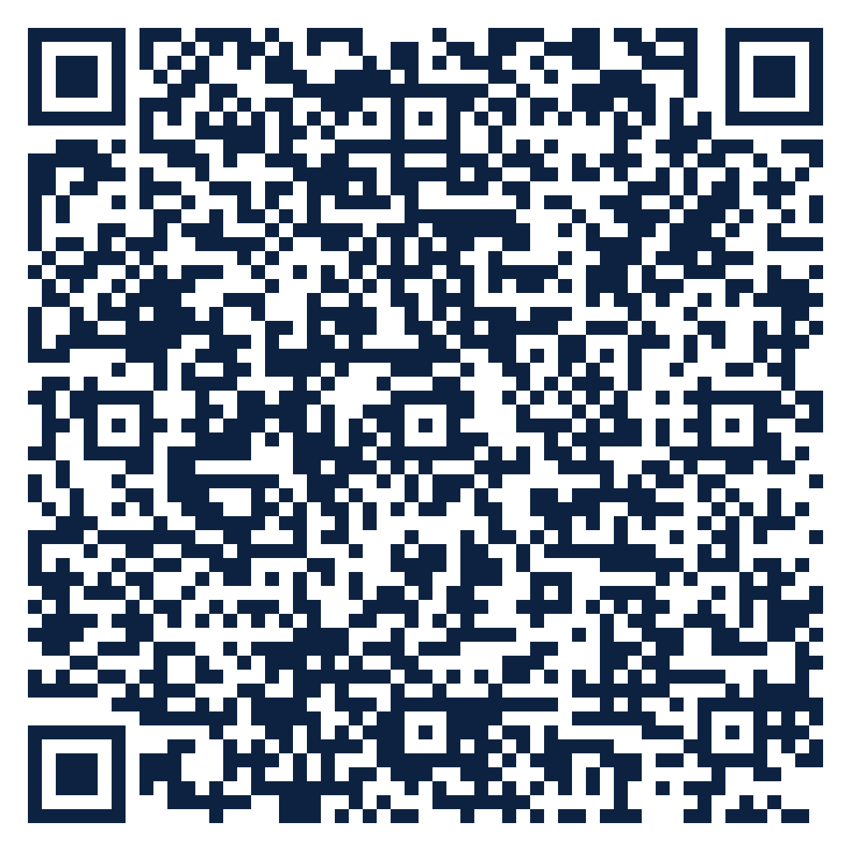
THE SEAT SERIES · FREE ATTENDANCE SCIENCE™ RESOURCE
SEAT
15
McKinney-Vento Liaisons · Pre-K to 12
McKinney-Vento Basics
Which rights keep a student experiencing homelessness in school, and how do they connect to attendance?
10 slides · 2 handouts · evidence from Schools Spared, Children Punished and the Attendance Science™ research base
attendanceusa.org | Questions: info@attendanceusa.org | Free to use and share with attribution
Take a seat
Notes:
Seat 15: McKinney-Vento Basics. For homeless education liaisons and student services. Open with the question on the slide and invite one minute of discussion. Free resource from Attendance USA; questions to info@attendanceusa.org.

Slide 2
SEAT 15 · 02 THE MOMENT
MCKINNEY-VENTO LIAISONS · PRE-K TO 12
The withdrawal that housing explains
“
Withdrawal is family-centered absence rooted in logistics, caregiving, housing instability or economic survival. When housing is the root, the McKinney-Vento Act already gives schools the tools: immediate enrollment, school stability and transportation. Attendance improves when the liaison is in the room from the first conversation.
Source: Schools Spared, Children Punished, Ch. 1 (Maria, composite case); McKinney-Vento Homeless Assistance Act, Subtitle VII-B (42 U.S.C. 11431 et seq.); National Center for Homeless Education
Every story in this series is a composite or a published case. Names are invented.
attendanceusa.org | Questions: info@attendanceusa.org | Free to use and share with attribution
Take a seat
Notes:
Tell the story in your own words. Source: Schools Spared, Children Punished, Ch. 1 (Maria, composite case); McKinney-Vento Homeless Assistance Act, Subtitle VII-B (42 U.S.C. 11431 et seq.); National Center for Homeless Education. Ask: where have you seen this pattern?

Slide 3
SEAT 15 · 03 THE QUESTION WE HEAR
MCKINNEY-VENTO LIAISONS · PRE-K TO 12
What liaisons are asking
Which rights keep a student experiencing homelessness in school, and how do they connect to attendance?
1
2
3
Doubled-up families rarely self-identify.
Missing records delay enrollment and add absences.
Attendance letters go to families who just lost housing.
attendanceusa.org | Questions: info@attendanceusa.org | Free to use and share with attribution
Take a seat
Notes:
These concerns come from the field: Attendance USA briefs, IATDP 2026 sessions, training cohorts and the book's practitioner stories. Ask which one is loudest in your building.

Slide 4
SEAT 15 · 04 NAME IT
MCKINNEY-VENTO LIAISONS · PRE-K TO 12
Shared words before shared work
H
L
S
Homeless (McKinney-Vento)
Local liaison
School of origin
Lacking a fixed, regular and adequate nighttime residence, including sharing housing due to loss of housing or economic hardship.
The staff member every school district must designate to identify and support these students.
The school attended when permanently housed, or last enrolled.
attendanceusa.org | Questions: info@attendanceusa.org | Free to use and share with attribution
Take a seat
Notes:
Definitions follow Schools Spared, Children Punished (glossary), the Attendance Kit, and the instruments' published materials.

Slide 5
SEAT 15 · 05 WHAT THE EVIDENCE SAYS
The numbers behind the moment
Day 1
Every LEA
Fees, fines, absences
immediate enrollment, even without records normally required
must designate a homeless education liaison
states must address these as barriers for homeless students under ESSA amendments
McKinney-Vento Homeless Assistance Act, Subtitle VII-B (42 U.S.C. 11431 et seq.); National Center for Homeless Education
McKinney-Vento Homeless Assistance Act, Subtitle VII-B (42 U.S.C. 11431 et seq.); National Center for Homeless Education
McKinney-Vento Homeless Assistance Act, Subtitle VII-B (42 U.S.C. 11431 et seq.); National Center for Homeless Education
attendanceusa.org | Questions: info@attendanceusa.org | Free to use and share with attribution
Take a seat
Notes:
Sources: Day 1 immediate enrollment, even without records normally required (McKinney-Vento Homeless Assistance Act, Subtitle VII-B (42 U.S.C. 11431 et seq.); National Center for Homeless Education); Every LEA must designate a homeless education liaison (McKinney-Vento Homeless Assistance Act, Subtitle VII-B (42 U.S.C. 11431 et seq.); National Center for Homeless Education); Fees, fines, absences states must address these as barriers for homeless students under ESSA amendments (McKinney-Vento Homeless Assistance Act, Subtitle VII-B (42 U.S.C. 11431 et seq.); National Center for Homeless Education). Figures labeled illustrative are teaching examples, not data. Check state and local figures against primary sources before presenting.

Slide 6
SEAT 15 · 06 CLASSIFY
MCKINNEY-VENTO LIAISONS · PRE-K TO 12
Classify before you consequence
Withdrawal
Avoidance
Most housing-related absence. Liaison first, never a truancy letter.
Stigma at a new school. Assign a welcoming adult.
Refusal
Truancy
Trauma and stress. Connect to counseling.
Rarely the right label for a student without stable housing.
attendanceusa.org | Questions: info@attendanceusa.org | Free to use and share with attribution
Take a seat
Notes:
Four-part classification (truancy, withdrawal, avoidance, refusal) from Schools Spared, Children Punished, Ch. 1, and the Attendance Kit Type Cards. Commitment One of No Empty Seats: no formal consequence before a conversation decides the category.

Slide 7
SEAT 15 · 07 MONDAY MOVES
MCKINNEY-VENTO LIAISONS · PRE-K TO 12
Three moves you can make this week
01
02
03
Cost: $0
Cost: $0
Cost: $0
Screen every enrollment
Flag before the letter
Train front office staff
Use a housing questionnaire at enrollment and re-enrollment.
Route any student with housing flags to the liaison before attendance notices.
Front desk and attendance clerks learn the signs and the referral path.
attendanceusa.org | Questions: info@attendanceusa.org | Free to use and share with attribution
Take a seat
Notes:
Monday Morning takeaways follow the book's chapter structure and the IATDP 2026 blueprint: start with what costs nothing. Handout A turns these into a checklist.

Slide 8
SEAT 15 · 08 FIND YOUR DATA
MCKINNEY-VENTO LIAISONS · PRE-K TO 12
A PRESENCE™ prompt for your building
P
R
E
S
E
N
C
E
Problem definition
Research evidence
Environmental context
Statistical analysis
Equity assessment
Network and partnership
Compliance and legal
Evidence-based recommendations
YOUR PROMPT
Compare your identified homeless count with free-meal and mobility data. A low identification rate signals students the system is missing.
attendanceusa.org | Questions: info@attendanceusa.org | Free to use and share with attribution
Take a seat
Notes:
PRESENCE: Problem definition, Research evidence, Environmental context, Statistical analysis, Equity assessment, Network and partnership, Compliance and legal, Evidence-based recommendations. Highlighted letters show the steps this prompt exercises. Handout B is the worksheet.

Slide 9
SEAT 15 · 09 AVOID AND MEASURE
MCKINNEY-VENTO LIAISONS · PRE-K TO 12
Common missteps, and how you will know it works
Requiring records before enrolling a student
LEADING INDICATOR · Moves first
✕
Students identified and connected within 5 days
Sending standard truancy notices to identified families
✕
LAGGING INDICATOR · Confirms it worked
Chronic absence for identified students
Assuming families will self-identify
✕
attendanceusa.org | Questions: info@attendanceusa.org | Free to use and share with attribution
Take a seat
Notes:
Missteps adapted from each chapter's Common Missteps section and the Kit tip sheets. Leading indicators move first; lagging indicators confirm.

Slide 10
SEAT 15 · 10 TAKE YOUR SEAT
Join 1,000 Seats at the national table
Scan to take your seat: free membership in Attendance USA and the weekly Attendance Intelligence Brief, with new research, policy across the states, and tools from the field of Attendance Science™.
QUESTIONS
info@attendanceusa.org
LEARN MORE
attendanceusa.org
Take Your Seat
HANDOUTS
Seat Card (A) and Find Your Data worksheet (B)
1,000 Seats campaign
KEEP GOING IN THIS SERIES
Seat 16: Getting There: Transportation and School Stability
Seat 17: Hidden Homelessness and Mid-Year Moves
Seat 18: Unaccompanied and Working Youth
Every seat filled is one more person working to make showing up possible.
attendanceusa.org | Questions: info@attendanceusa.org | Free to use and share with attribution
Take a seat
Notes:
Close with the question: have we created a place worth showing up for? Point to the QR code (1,000 Seats subscribe form). Questions: info@attendanceusa.org. Website: attendanceusa.org.

