Slide 1


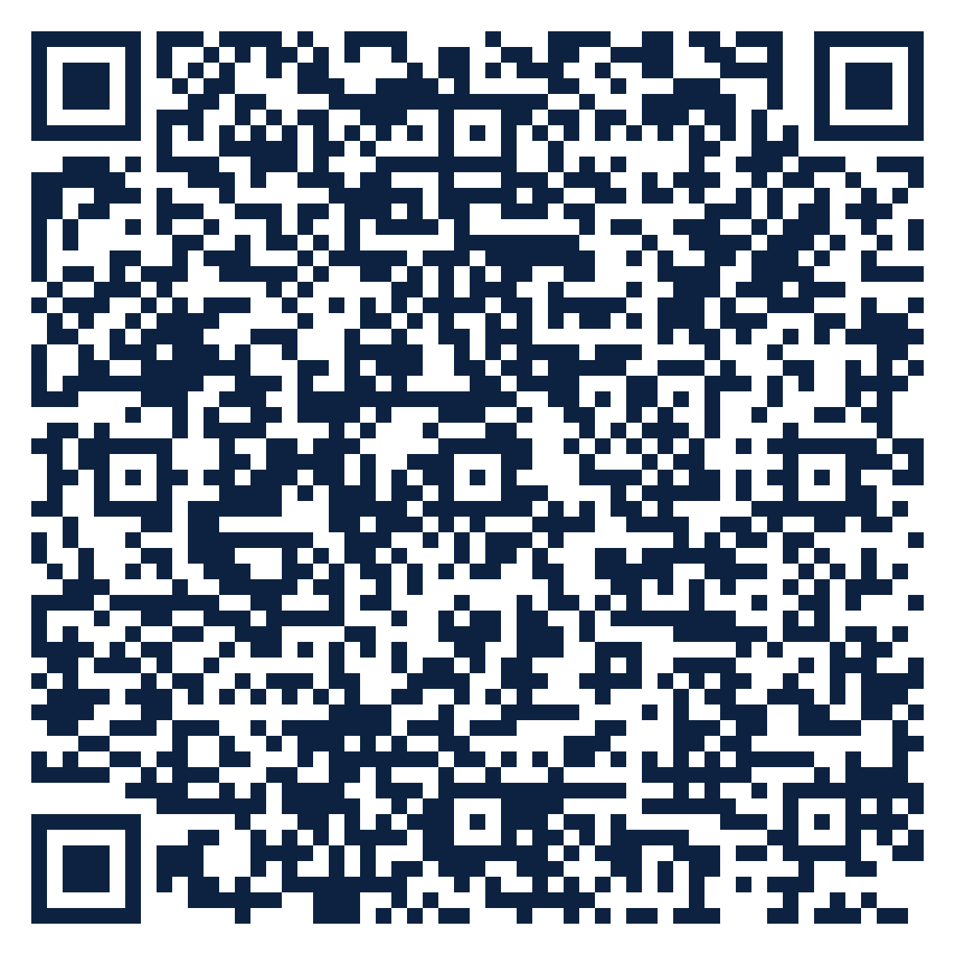
THE SEAT SERIES · FREE ATTENDANCE SCIENCE™ RESOURCE
SEAT
20
Administrators · K-12
No Empty Seats: Four Commitments for Leaders
What standard should our district hold itself to on attendance?
10 slides · 2 handouts · evidence from Schools Spared, Children Punished and the Attendance Science™ research base
attendanceusa.org | Questions: info@attendanceusa.org | Free to use and share with attribution
Take a seat
Notes:
Seat 20: No Empty Seats: Four Commitments for Leaders. For principals, district leaders and school boards. Open with the question on the slide and invite one minute of discussion. Free resource from Attendance USA; questions to info@attendanceusa.org.

Slide 2
SEAT 20 · 02 THE MOMENT
ADMINISTRATORS · K-12
A public standard on one page
“
No Empty Seats distills a decade of research into four commitments districts, states and policymakers can be measured against. It fits on a single page precisely because the evidence behind it is deep.
Source: Attendance USA, No Empty Seats National Position Statement
Every story in this series is a composite or a published case. Names are invented.
attendanceusa.org | Questions: info@attendanceusa.org | Free to use and share with attribution
Take a seat
Notes:
Tell the story in your own words. Source: Attendance USA, No Empty Seats National Position Statement. Ask: where have you seen this pattern?

Slide 3
SEAT 20 · 03 THE QUESTION WE HEAR
ADMINISTRATORS · K-12
What school leaders are asking
What standard should our district hold itself to on attendance?
1
2
3
Initiatives pile up without changing enforcement-first policy.
Staff learn new language while old protocols stay in force.
Boards want outcomes, not activity.
attendanceusa.org | Questions: info@attendanceusa.org | Free to use and share with attribution
Take a seat
Notes:
These concerns come from the field: Attendance USA briefs, IATDP 2026 sessions, training cohorts and the book's practitioner stories. Ask which one is loudest in your building.

Slide 4
SEAT 20 · 04 NAME IT
ADMINISTRATORS · K-12
Shared words before shared work
C
C
C
Commitment 1 and 2
Commitment 3
Commitment 4
Classify before you consequence. Measure the bond, not just the seat.
Respond strengths-first with SALT, before any enforcement escalation.
Coordinate across every system, with an owner for every seam.
attendanceusa.org | Questions: info@attendanceusa.org | Free to use and share with attribution
Take a seat
Notes:
Definitions follow Schools Spared, Children Punished (glossary), the Attendance Kit, and the instruments' published materials.

Slide 5
SEAT 20 · 05 WHAT THE EVIDENCE SAYS
The numbers behind the moment
36+
18 states
~22-24%
state ESSA plans include chronic absenteeism as an accountability indicator
adopted the goal to cut 2022 chronic absence in half by 2027
national chronic absence, still well above the pre-pandemic 13-15%
Attendance USA Attendance Intelligence Briefs, Aug to Oct 2026 (primary-source checked)
Attendance USA Attendance Intelligence Briefs, Aug to Oct 2026 (primary-source checked)
RAND ASDP (2025); AEI Return to Learn Tracker (Malkus, 2026); FutureEd (2026)
attendanceusa.org | Questions: info@attendanceusa.org | Free to use and share with attribution
Take a seat
Notes:
Sources: 36+ state ESSA plans include chronic absenteeism as an accountability indicator (Attendance USA Attendance Intelligence Briefs, Aug to Oct 2026 (primary-source checked)); 18 states adopted the goal to cut 2022 chronic absence in half by 2027 (Attendance USA Attendance Intelligence Briefs, Aug to Oct 2026 (primary-source checked)); ~22-24% national chronic absence, still well above the pre-pandemic 13-15% (RAND ASDP (2025); AEI Return to Learn Tracker (Malkus, 2026); FutureEd (2026)). Figures labeled illustrative are teaching examples, not data. Check state and local figures against primary sources before presenting.

Slide 6
SEAT 20 · 06 CLASSIFY
ADMINISTRATORS · K-12
Match the response to the reason
Classify
Measure
Policy requires a conversation before any formal step.
Adopt PSSB alongside attendance codes.
Respond
Coordinate
SALT plans before escalation.
Named owners for every seam.
attendanceusa.org | Questions: info@attendanceusa.org | Free to use and share with attribution
Take a seat
Notes:
Four-part classification (truancy, withdrawal, avoidance, refusal) from Schools Spared, Children Punished, Ch. 1, and the Attendance Kit Type Cards. Commitment One of No Empty Seats: no formal consequence before a conversation decides the category.

Slide 7
SEAT 20 · 07 MONDAY MOVES
ADMINISTRATORS · K-12
Three moves you can make this week
01
02
03
Cost: $0
Cost: $0
Cost: $0
Replace, do not add
Sequence the rollout
Track local evidence
Revise policy so the four commitments replace enforcement-first steps.
Classification first, then PSSB, then SALT once staff trust the classification step.
Record category, intervention and 90-day outcome for each case.
attendanceusa.org | Questions: info@attendanceusa.org | Free to use and share with attribution
Take a seat
Notes:
Monday Morning takeaways follow the book's chapter structure and the IATDP 2026 blueprint: start with what costs nothing. Handout A turns these into a checklist.

Slide 8
SEAT 20 · 08 FIND YOUR DATA
ADMINISTRATORS · K-12
A PRESENCE™ prompt for your building
P
R
E
S
E
N
C
E
Problem definition
Research evidence
Environmental context
Statistical analysis
Equity assessment
Network and partnership
Compliance and legal
Evidence-based recommendations
YOUR PROMPT
Score your current policy against each commitment: present, partial or absent. That scorecard is your board's starting point.
attendanceusa.org | Questions: info@attendanceusa.org | Free to use and share with attribution
Take a seat
Notes:
PRESENCE: Problem definition, Research evidence, Environmental context, Statistical analysis, Equity assessment, Network and partnership, Compliance and legal, Evidence-based recommendations. Highlighted letters show the steps this prompt exercises. Handout B is the worksheet.

Slide 9
SEAT 20 · 09 AVOID AND MEASURE
ADMINISTRATORS · K-12
Common missteps, and how you will know it works
Layering training onto unchanged policy
LEADING INDICATOR · Moves first
✕
Policy alignment with the four commitments
Rushing past resistance; it is where durable change happens
✕
LAGGING INDICATOR · Confirms it worked
Chronic absence and referrals avoided
Reporting activity counts instead of outcomes
✕
attendanceusa.org | Questions: info@attendanceusa.org | Free to use and share with attribution
Take a seat
Notes:
Missteps adapted from each chapter's Common Missteps section and the Kit tip sheets. Leading indicators move first; lagging indicators confirm.

Slide 10
SEAT 20 · 10 TAKE YOUR SEAT
Join 1,000 Seats at the national table
Scan to take your seat: free membership in Attendance USA and the weekly Attendance Intelligence Brief, with new research, policy across the states, and tools from the field of Attendance Science™.
QUESTIONS
info@attendanceusa.org
LEARN MORE
attendanceusa.org
Take Your Seat
HANDOUTS
Seat Card (A) and Find Your Data worksheet (B)
1,000 Seats campaign
KEEP GOING IN THIS SERIES
Seat 21: Policy That Classifies
Seat 22: Climate Is an Attendance Strategy
Seat 23: Discipline That Keeps Students Present
Every seat filled is one more person working to make showing up possible.
attendanceusa.org | Questions: info@attendanceusa.org | Free to use and share with attribution
Take a seat
Notes:
Close with the question: have we created a place worth showing up for? Point to the QR code (1,000 Seats subscribe form). Questions: info@attendanceusa.org. Website: attendanceusa.org.

