Slide 1


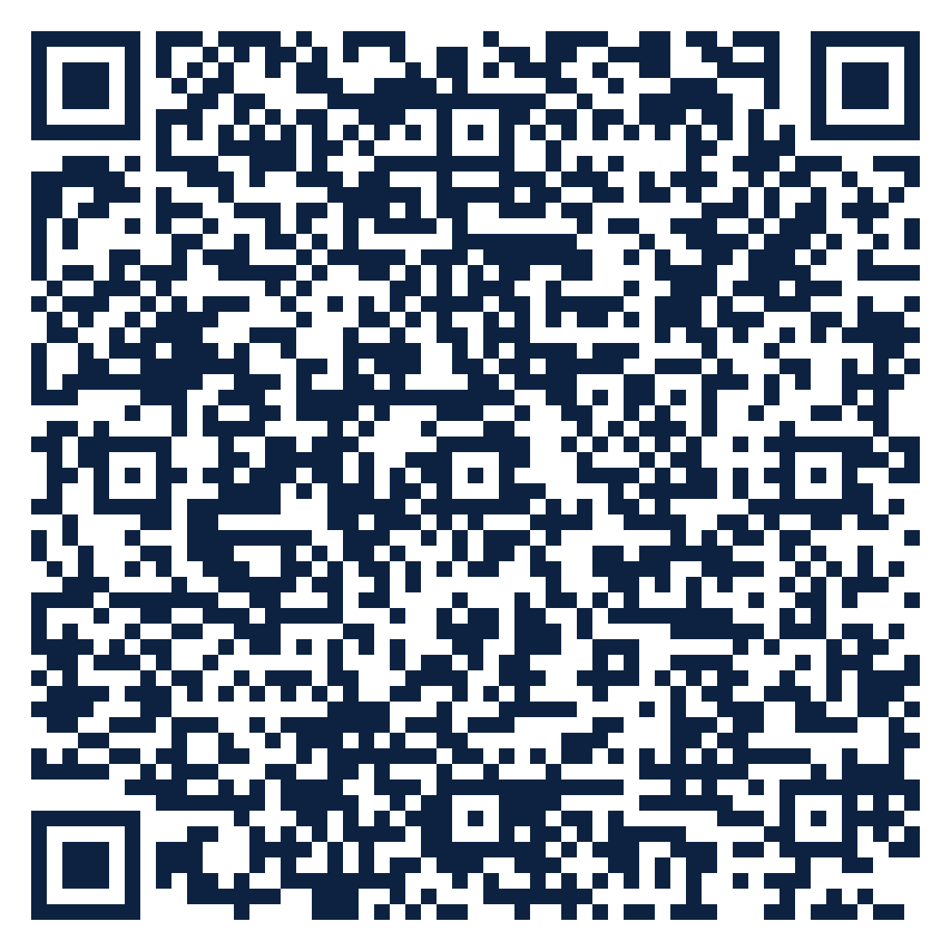
THE SEAT SERIES · FREE ATTENDANCE SCIENCE™ RESOURCE
SEAT
26
Technology and Data Teams · K-12
Codes That Tell the Truth
How do we build the four reasons into our student information system?
10 slides · 2 handouts · evidence from Schools Spared, Children Punished and the Attendance Science™ research base
attendanceusa.org | Questions: info@attendanceusa.org | Free to use and share with attribution
Take a seat
Notes:
Seat 26: Codes That Tell the Truth. For data analysts, SIS managers and IT partners. Open with the question on the slide and invite one minute of discussion. Free resource from Attendance USA; questions to info@attendanceusa.org.

Slide 2
SEAT 26 · 02 THE MOMENT
TECHNOLOGY AND DATA TEAMS · K-12
The registrar's summer spreadsheet
“
A registrar's system offered two non-medical codes: excused and unexcused. An eviction, a fear of a classmate and no call at all landed in one bucket. She re-coded three years by hand. Nearly 40% of what the data called truancy was withdrawal or avoidance.
Source: Schools Spared, Ch. 1, Another Voice from the Field
Every story in this series is a composite or a published case. Names are invented.
attendanceusa.org | Questions: info@attendanceusa.org | Free to use and share with attribution
Take a seat
Notes:
Tell the story in your own words. Source: Schools Spared, Ch. 1, Another Voice from the Field. Ask: where have you seen this pattern?

Slide 3
SEAT 26 · 03 THE QUESTION WE HEAR
TECHNOLOGY AND DATA TEAMS · K-12
What data teams are asking
How do we build the four reasons into our student information system?
1
2
3
Software was procured before classification existed.
Staff can only enter the codes the menu offers.
New state laws require category reporting.
attendanceusa.org | Questions: info@attendanceusa.org | Free to use and share with attribution
Take a seat
Notes:
These concerns come from the field: Attendance USA briefs, IATDP 2026 sessions, training cohorts and the book's practitioner stories. Ask which one is loudest in your building.

Slide 4
SEAT 26 · 04 NAME IT
TECHNOLOGY AND DATA TEAMS · K-12
Shared words before shared work
A
C
R
Attendance code
Category reporting
Re-classification
A data-entry outcome, never a diagnosis.
Recording absence reasons, as in Indiana's SEA 482 framework.
Updating a case's category as new information arrives.
attendanceusa.org | Questions: info@attendanceusa.org | Free to use and share with attribution
Take a seat
Notes:
Definitions follow Schools Spared, Children Punished (glossary), the Attendance Kit, and the instruments' published materials.

Slide 5
SEAT 26 · 05 WHAT THE EVIDENCE SAYS
The numbers behind the moment
~40%
2025
SEA 482
of 'truancy' was withdrawal or avoidance after re-coding
Warren Township among the first districts to apply the four classifications to its codes
Indiana statewide absence-category reporting, effective July 1, 2025
Schools Spared, Ch. 1, Another Voice from the Field
Schools Spared, Children Punished, Ch. 3: MSD of Warren Township case study
Attendance USA Attendance Intelligence Briefs, Aug to Oct 2026 (primary-source checked)
attendanceusa.org | Questions: info@attendanceusa.org | Free to use and share with attribution
Take a seat
Notes:
Sources: ~40% of 'truancy' was withdrawal or avoidance after re-coding (Schools Spared, Ch. 1, Another Voice from the Field); 2025 Warren Township among the first districts to apply the four classifications to its codes (Schools Spared, Children Punished, Ch. 3: MSD of Warren Township case study); SEA 482 Indiana statewide absence-category reporting, effective July 1, 2025 (Attendance USA Attendance Intelligence Briefs, Aug to Oct 2026 (primary-source checked)). Figures labeled illustrative are teaching examples, not data. Check state and local figures against primary sources before presenting.

Slide 6
SEAT 26 · 06 CLASSIFY
TECHNOLOGY AND DATA TEAMS · K-12
Classify before you consequence
Truancy
Withdrawal
Code only after a documented conversation.
Sub-codes: transport, caregiving, housing, economic.
Avoidance
Refusal
Sub-codes: bullying, climate, specific class or time.
Sub-codes: anxiety, health; protect privacy.
attendanceusa.org | Questions: info@attendanceusa.org | Free to use and share with attribution
Take a seat
Notes:
Four-part classification (truancy, withdrawal, avoidance, refusal) from Schools Spared, Children Punished, Ch. 1, and the Attendance Kit Type Cards. Commitment One of No Empty Seats: no formal consequence before a conversation decides the category.

Slide 7
SEAT 26 · 07 MONDAY MOVES
TECHNOLOGY AND DATA TEAMS · K-12
Three moves you can make this week
01
02
03
Cost: $0
Low cost
Cost: $0
Audit the menu
Add a reason field
Train the front desk
List every code staff can choose today.
Add the four reasons as a required field after a conversation.
Show staff entering data what each code means.
attendanceusa.org | Questions: info@attendanceusa.org | Free to use and share with attribution
Take a seat
Notes:
Monday Morning takeaways follow the book's chapter structure and the IATDP 2026 blueprint: start with what costs nothing. Handout A turns these into a checklist.

Slide 8
SEAT 26 · 08 FIND YOUR DATA
TECHNOLOGY AND DATA TEAMS · K-12
A PRESENCE™ prompt for your building
P
R
E
S
E
N
C
E
Problem definition
Research evidence
Environmental context
Statistical analysis
Equity assessment
Network and partnership
Compliance and legal
Evidence-based recommendations
YOUR PROMPT
Export one semester of codes. What share is 'unexcused' with no reason recorded? That is your misclassification risk.
attendanceusa.org | Questions: info@attendanceusa.org | Free to use and share with attribution
Take a seat
Notes:
PRESENCE: Problem definition, Research evidence, Environmental context, Statistical analysis, Equity assessment, Network and partnership, Compliance and legal, Evidence-based recommendations. Highlighted letters show the steps this prompt exercises. Handout B is the worksheet.

Slide 9
SEAT 26 · 09 AVOID AND MEASURE
TECHNOLOGY AND DATA TEAMS · K-12
Common missteps, and how you will know it works
Letting the default code decide the category
LEADING INDICATOR · Moves first
✕
Absences with a recorded reason
Adding codes without training staff
✕
LAGGING INDICATOR · Confirms it worked
Share coded unexcused with no reason
Recording sensitive health details in open fields
✕
attendanceusa.org | Questions: info@attendanceusa.org | Free to use and share with attribution
Take a seat
Notes:
Missteps adapted from each chapter's Common Missteps section and the Kit tip sheets. Leading indicators move first; lagging indicators confirm.

Slide 10
SEAT 26 · 10 TAKE YOUR SEAT
Join 1,000 Seats at the national table
Scan to take your seat: free membership in Attendance USA and the weekly Attendance Intelligence Brief, with new research, policy across the states, and tools from the field of Attendance Science™.
QUESTIONS
info@attendanceusa.org
LEARN MORE
attendanceusa.org
Take Your Seat
HANDOUTS
Seat Card (A) and Find Your Data worksheet (B)
1,000 Seats campaign
KEEP GOING IN THIS SERIES
Seat 27: Beyond the Login
Seat 28: Predictive Models That Trigger Care
Seat 29: Linking the Data You Already Hold
Every seat filled is one more person working to make showing up possible.
attendanceusa.org | Questions: info@attendanceusa.org | Free to use and share with attribution
Take a seat
Notes:
Close with the question: have we created a place worth showing up for? Point to the QR code (1,000 Seats subscribe form). Questions: info@attendanceusa.org. Website: attendanceusa.org.

