Slide 1


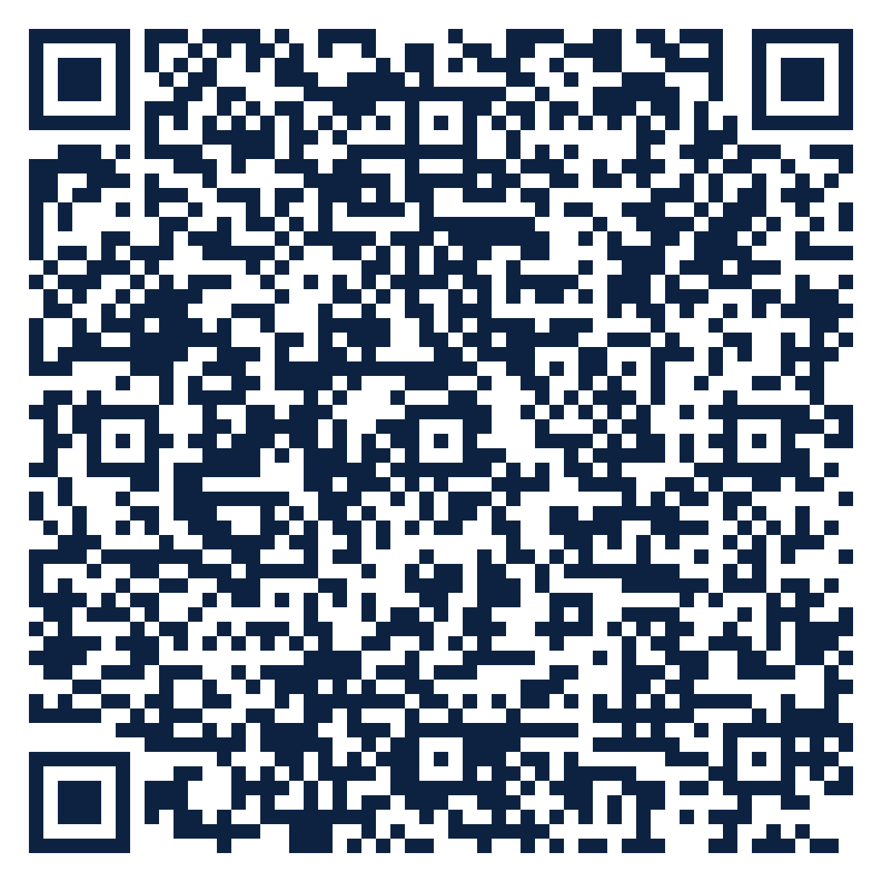
THE SEAT SERIES · FREE ATTENDANCE SCIENCE™ RESOURCE
SEAT
31
Attendance Teams · K-12
An Attendance Team That Owns the Next Step
How should our attendance team be built so every case has an owner and a clock?
10 slides · 2 handouts · evidence from Schools Spared, Children Punished and the Attendance Science™ research base
attendanceusa.org | Questions: info@attendanceusa.org | Free to use and share with attribution
Take a seat
Notes:
Seat 31: An Attendance Team That Owns the Next Step. For school and district attendance teams. Open with the question on the slide and invite one minute of discussion. Free resource from Attendance USA; questions to info@attendanceusa.org.

Slide 2
SEAT 31 · 02 THE MOMENT
ATTENDANCE TEAMS · K-12
Every response needs an owner and a clock
“
At the 114th IATDP conference, five threads ran through the week. One was simple: who owns the next action, how fast, and did it work? Coordination is a workflow, not a hope.
Source: Gentle-Genitty, Attendance Talk, 114th IATDP Conference, Corpus Christi (Oct 21, 2026)
Every story in this series is a composite or a published case. Names are invented.
attendanceusa.org | Questions: info@attendanceusa.org | Free to use and share with attribution
Take a seat
Notes:
Tell the story in your own words. Source: Gentle-Genitty, Attendance Talk, 114th IATDP Conference, Corpus Christi (Oct 21, 2026). Ask: where have you seen this pattern?

Slide 3
SEAT 31 · 03 THE QUESTION WE HEAR
ATTENDANCE TEAMS · K-12
What attendance teams are asking
How should our attendance team be built so every case has an owner and a clock?
1
2
3
Meetings review lists without assigning owners.
Cases stall between offices.
Teams track counts but not outcomes.
attendanceusa.org | Questions: info@attendanceusa.org | Free to use and share with attribution
Take a seat
Notes:
These concerns come from the field: Attendance USA briefs, IATDP 2026 sessions, training cohorts and the book's practitioner stories. Ask which one is loudest in your building.

Slide 4
SEAT 31 · 04 NAME IT
ATTENDANCE TEAMS · K-12
Shared words before shared work
O
C
S
Owner
Clock
Seam owner
One named person responsible for the next action.
A date by which the action happens.
The person accountable for gaps between systems.
attendanceusa.org | Questions: info@attendanceusa.org | Free to use and share with attribution
Take a seat
Notes:
Definitions follow Schools Spared, Children Punished (glossary), the Attendance Kit, and the instruments' published materials.

Slide 5
SEAT 31 · 05 WHAT THE EVIDENCE SAYS
The numbers behind the moment
10 days
77%
4
data refresh in tiered early-warning systems
of schools using effective strategies reduce chronic absence
No Empty Seats commitments to guide every case
Gentle-Genitty, Your Presence Matters national deck (2026)
HEDCO Institute meta-analysis, University of Oregon (2025-2026), 49 U.S. studies
Attendance USA, No Empty Seats National Position Statement
attendanceusa.org | Questions: info@attendanceusa.org | Free to use and share with attribution
Take a seat
Notes:
Sources: 10 days data refresh in tiered early-warning systems (Gentle-Genitty, Your Presence Matters national deck (2026)); 77% of schools using effective strategies reduce chronic absence (HEDCO Institute meta-analysis, University of Oregon (2025-2026), 49 U.S. studies); 4 No Empty Seats commitments to guide every case (Attendance USA, No Empty Seats National Position Statement). Figures labeled illustrative are teaching examples, not data. Check state and local figures against primary sources before presenting.

Slide 6
SEAT 31 · 06 CLASSIFY
ATTENDANCE TEAMS · K-12
Match the response to the reason
Teacher
Counselor / social worker
Notices and asks why first.
Classifies and builds SALT plans.
Liaisons
Administrator
Housing, foster care, family partners.
Removes structural barriers.
attendanceusa.org | Questions: info@attendanceusa.org | Free to use and share with attribution
Take a seat
Notes:
Four-part classification (truancy, withdrawal, avoidance, refusal) from Schools Spared, Children Punished, Ch. 1, and the Attendance Kit Type Cards. Commitment One of No Empty Seats: no formal consequence before a conversation decides the category.

Slide 7
SEAT 31 · 07 MONDAY MOVES
ATTENDANCE TEAMS · K-12
Three moves you can make this week
01
02
03
Cost: $0
Cost: $0
Cost: $0
Name an attendance lead
Owner and date on every case
Close the loop
One person runs the review and tracks owners.
No case leaves the meeting without both.
Each review starts with: did last time's actions happen?
attendanceusa.org | Questions: info@attendanceusa.org | Free to use and share with attribution
Take a seat
Notes:
Monday Morning takeaways follow the book's chapter structure and the IATDP 2026 blueprint: start with what costs nothing. Handout A turns these into a checklist.

Slide 8
SEAT 31 · 08 FIND YOUR DATA
ATTENDANCE TEAMS · K-12
A PRESENCE™ prompt for your building
P
R
E
S
E
N
C
E
Problem definition
Research evidence
Environmental context
Statistical analysis
Equity assessment
Network and partnership
Compliance and legal
Evidence-based recommendations
YOUR PROMPT
Review last month's cases. What share had a named owner and a date? What share of actions happened?
attendanceusa.org | Questions: info@attendanceusa.org | Free to use and share with attribution
Take a seat
Notes:
PRESENCE: Problem definition, Research evidence, Environmental context, Statistical analysis, Equity assessment, Network and partnership, Compliance and legal, Evidence-based recommendations. Highlighted letters show the steps this prompt exercises. Handout B is the worksheet.

Slide 9
SEAT 31 · 09 AVOID AND MEASURE
ATTENDANCE TEAMS · K-12
Common missteps, and how you will know it works
Reviewing lists without assigning actions
LEADING INDICATOR · Moves first
✕
Cases with owner and date
One person carrying every case
✕
LAGGING INDICATOR · Confirms it worked
Actions completed on time
Skipping follow-up on past actions
✕
attendanceusa.org | Questions: info@attendanceusa.org | Free to use and share with attribution
Take a seat
Notes:
Missteps adapted from each chapter's Common Missteps section and the Kit tip sheets. Leading indicators move first; lagging indicators confirm.

Slide 10
SEAT 31 · 10 TAKE YOUR SEAT
Join 1,000 Seats at the national table
Scan to take your seat: free membership in Attendance USA and the weekly Attendance Intelligence Brief, with new research, policy across the states, and tools from the field of Attendance Science™.
QUESTIONS
info@attendanceusa.org
LEARN MORE
attendanceusa.org
Take Your Seat
HANDOUTS
Seat Card (A) and Find Your Data worksheet (B)
1,000 Seats campaign
KEEP GOING IN THIS SERIES
Seat 32: The Ten-Day Review Cycle
Seat 33: Tiered Supports: Who Needs What
Seat 34: Relationship Mapping
Every seat filled is one more person working to make showing up possible.
attendanceusa.org | Questions: info@attendanceusa.org | Free to use and share with attribution
Take a seat
Notes:
Close with the question: have we created a place worth showing up for? Point to the QR code (1,000 Seats subscribe form). Questions: info@attendanceusa.org. Website: attendanceusa.org.

